Slide 1

WEEK 13
CESAR A. PASCAL VASQUEZ

Slide 2
Since the main objective of the project is to design the experiment, I dedicated time to preparing an experiment manual that describes each section of the process in detail and explains how to complete it step by step.

Slide 3
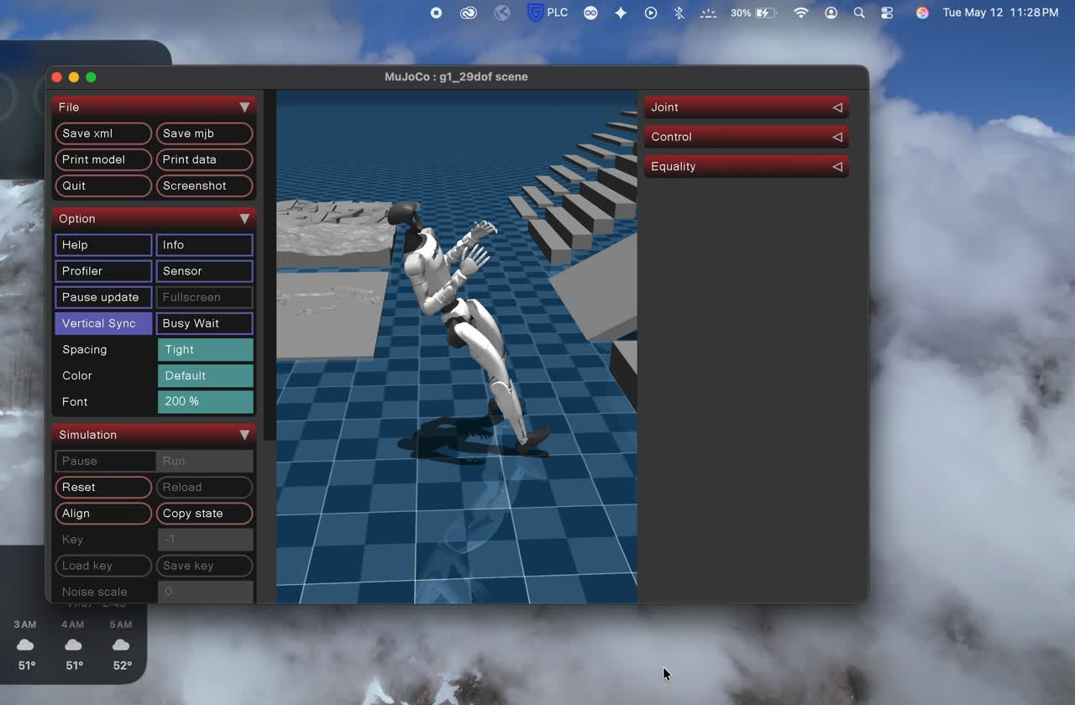
The manual is designed in a way that gives users some freedom to modify and customize their own work. By following these steps, it was possible to create a training model that can be visualized while it is being trained.

Slide 4
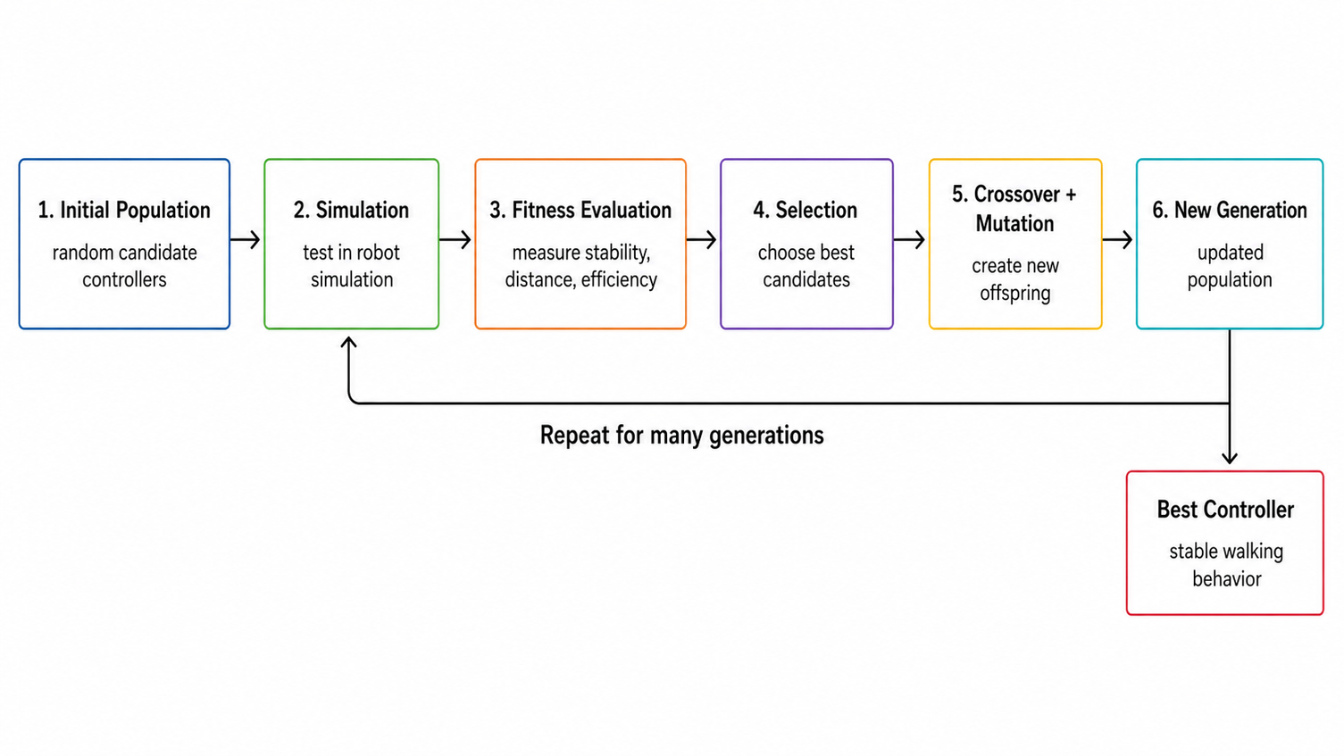
Recently, I started exploring the idea of using a genetic algorithm to train the robot. I will spend time investigating whether this method is feasible and whether it can provide an optimal or efficient training approach.

